Slide 1


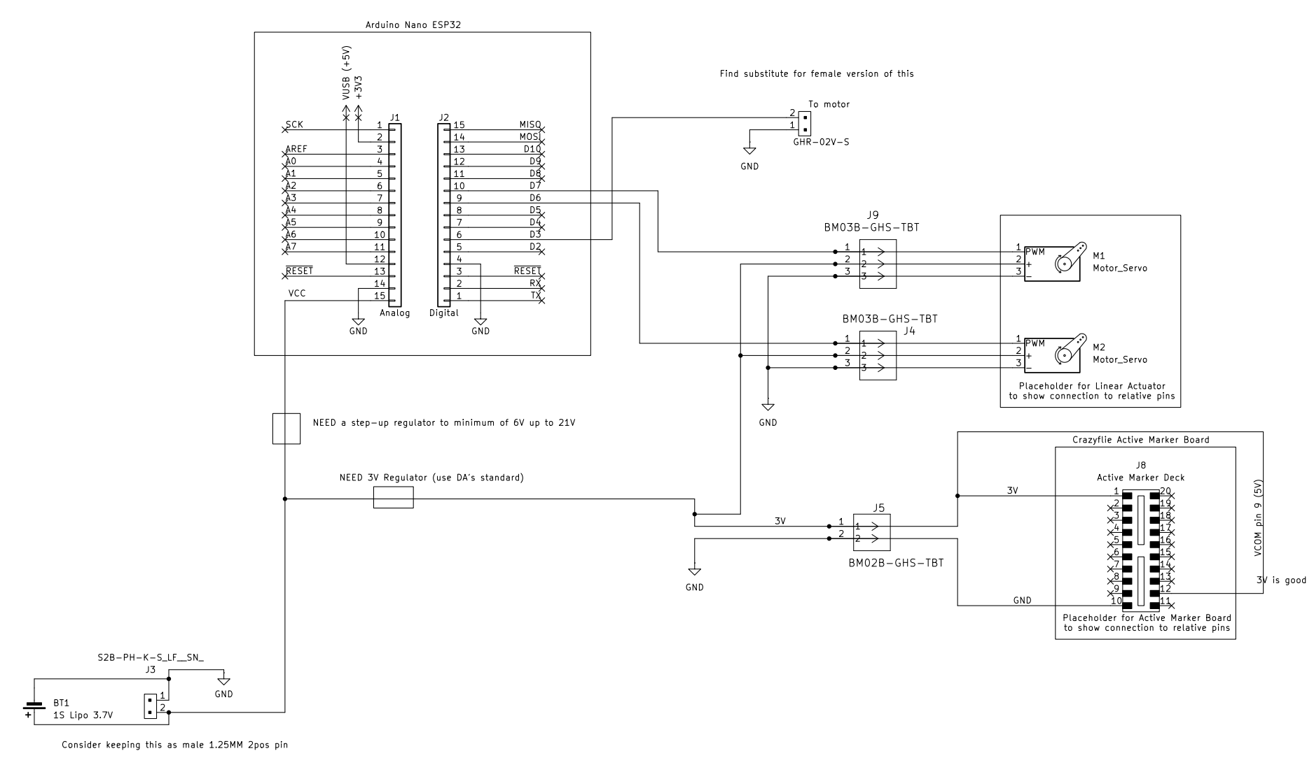
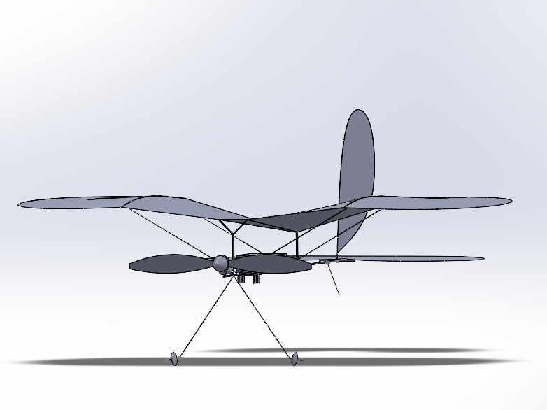
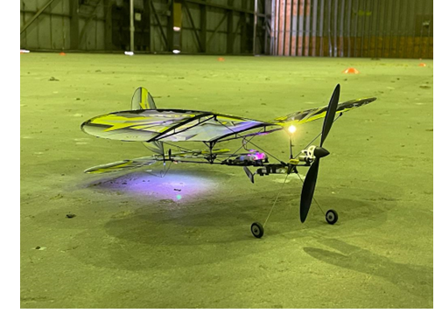
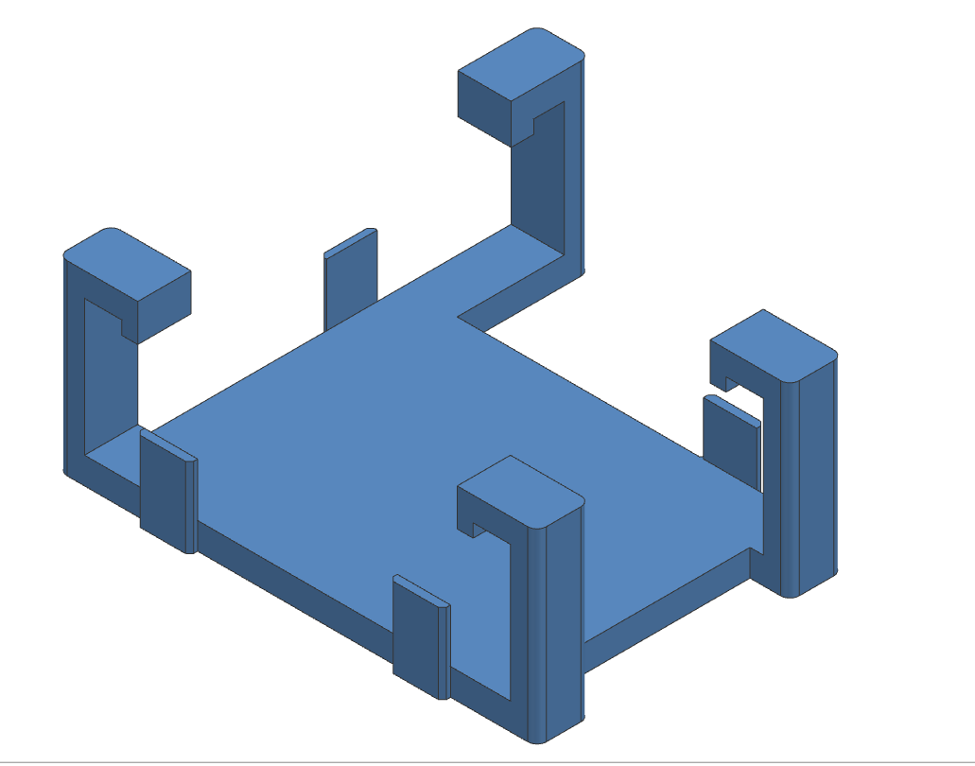
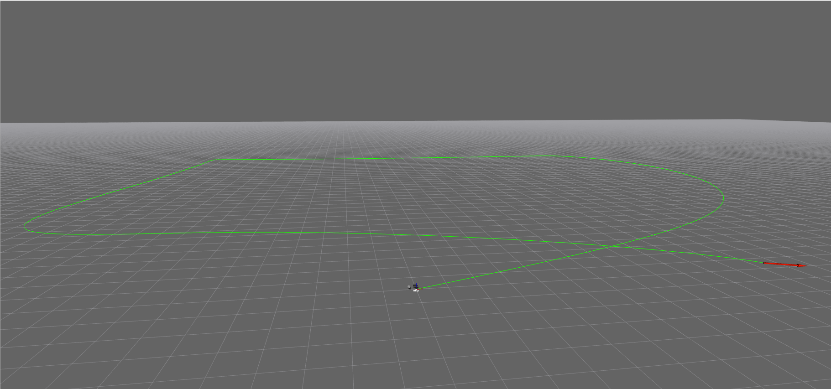
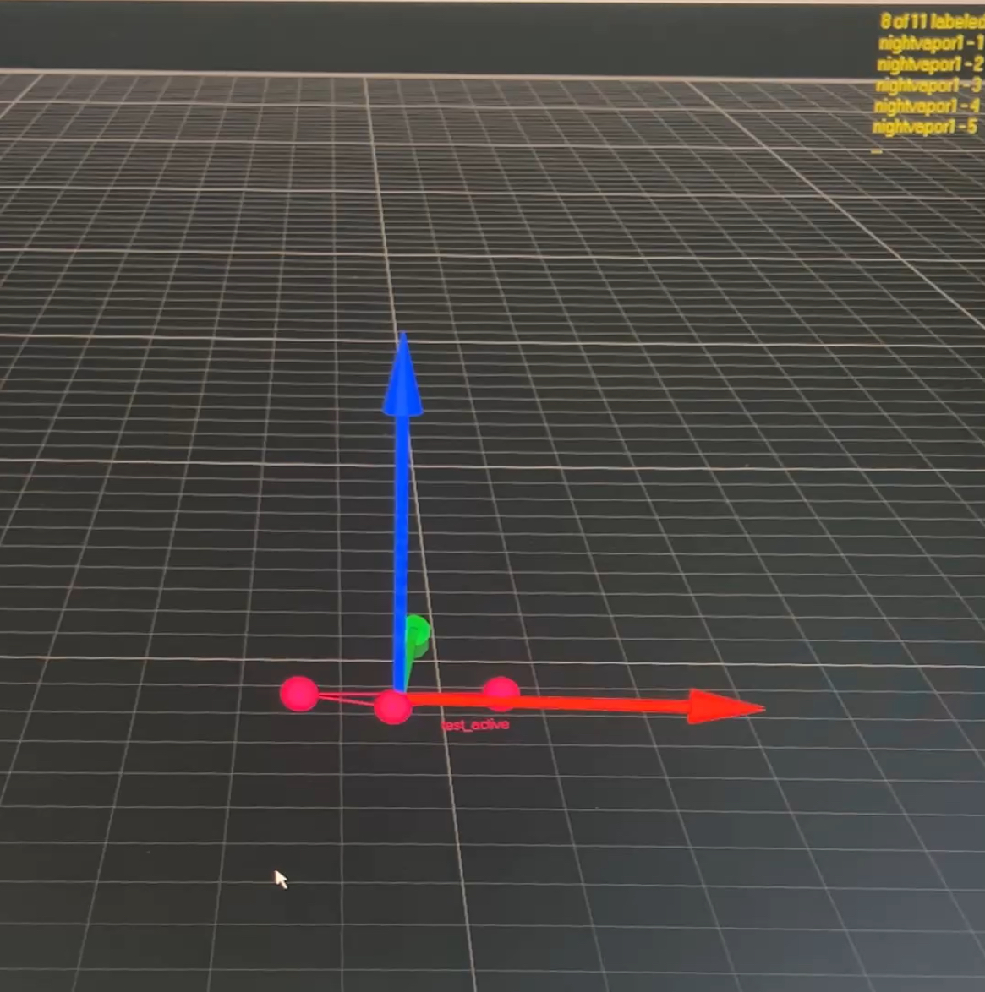
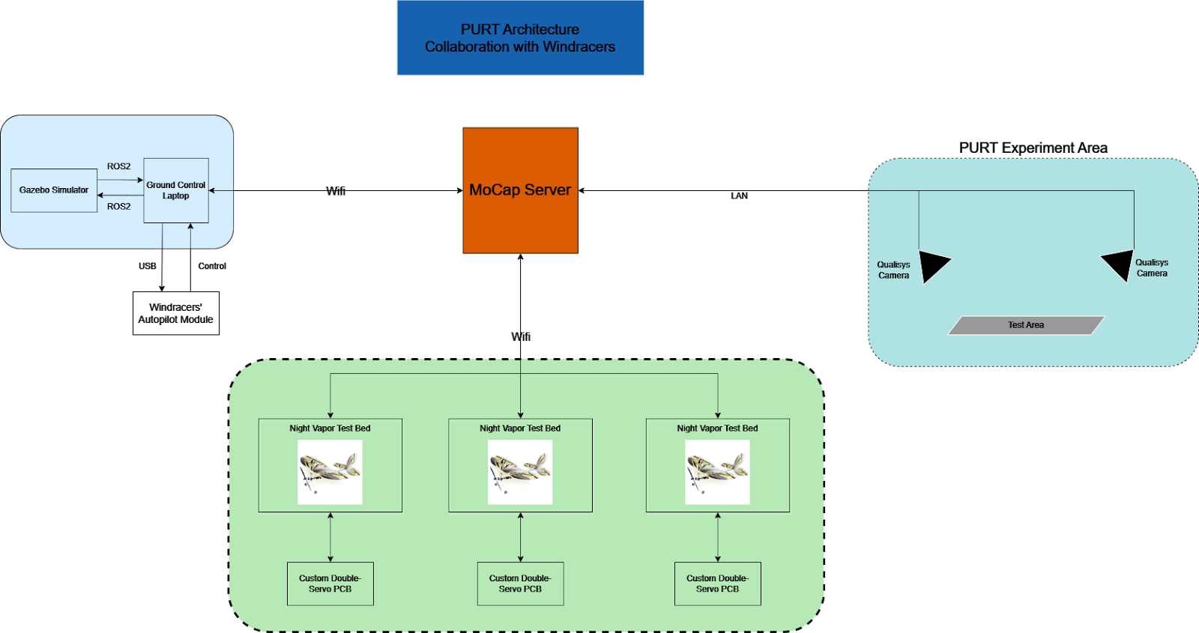
Autonomous Flight of Fixed-Wing Aircraft Using Motion Capture
Authors: J. Slater, B. Callaway, A. Kaufmann, B. Neely, N. Zagata
Abstract
Design
Conclusions
This research focuses on the development and testing of autopilot systems for lightweight unmanned fixed-wing aircraft within a controlled environment, utilizing the Purdue University PURT facility. The study aims to create a simple fixed-wing aircraft using predominantly off-the-shelf components, replicating the characteristics of the Windracers fixed-wing aircraft, for comprehensive testing under various conditions.
The design of the aircraft allows for the simultaneous operation of multiple units, facilitated by an active LED marker board that distinguishes and identifies individual aircraft. This feature enhances the scalability and efficiency of experimentation within the PURT testing facility.
PURT serves as a motion capture facility, leveraging an array of cameras to simulate sensors on the aircraft and gather comprehensive data during flight operations. This innovative approach enables researchers to evaluate and refine the performance of autopilot systems under a range of simulated conditions, providing valuable insights into navigation, control algorithms, and overall system robustness.
The integration of autopilot technology in lightweight unmanned fixed-wing aircraft holds significant potential for various applications, including surveillance, monitoring, and data collection in challenging environments. The results of this research contribute to the advancement of autonomous aerial systems, offering a platform for further developments in the field of unmanned aerial vehicles.
Active Marker Board:
The onboard system now utilizes an active marker board. Prior to this semester, the system relied on a passive marker system for triangulation and data collection. While they eliminated extra cost and had no power requirements, this would not be effective for the goals of this project in the long term. Passive markers rely on external environmental factors to reflect the light necessary to display on the MOCAP system in PURT. On the other hand, active markers – while they require a power supply – are able to emit a strong, steady signal in environments with high interference, which the final output of this project is expected to maintain.
Onboard Circuit Design:
The final circuit design was the result of a proof-of-concept to power both the servo board and the active marker board from the same power supply.
We aimed to incorporate the stock battery and the stock servo into our final solution, as the clearance to reach the both components onboard was too small to replace without requiring more effort and complexity than necessary.
Our only roadblock was to mitigate the 3.7V charge emitted by the battery, as both components required a total voltage of 5V. Our solution is a step-up regulator placed in between the power supply and the components.
The platform created will help Windracers perform testing, and ultimately, reduced the number of pilots needed to operate each drone
Challenges Faced:
Creating secure mounting for all new components during testing phase
Scaling down/simplifying circuitry to be lighter and more compact
Developing cheap and reliable manufacturing methods to replicate drones
Resolving issues with PID controller tuning and flight path angle estimation
Aircraft Design:
The main airframe is a UMX Night Vapor. This aircraft fits our design needs because of its extremely light weight and slow stall speed. We attached the active marker board to the center of the aircraft to alter the center of gravity to our liking, along with LEDs on specific points on the aircraft's wings. These points are used by the motion capture system to determine the roll pitch and yaw of the aircraft during flight.
CAD Aircraft Design:
A simplified model of the Night Vapor aircraft that will be used was created using computer modeling software to be able to model the movements of the Night Vapors in Gazebo simulations.
Future Work
Mounted Bracket Design:
This bracket was designed to securely attach the active marker board to the UMX Night Vapor while still allowing the board to be quickly and easily removed. We decided to mount the active marker board to the bottom of the Night Vapor because it changed the center of gravity to better suit our goals, and it provided the most stable mounting to the aircraft.
Complete phase A and move to phase B...
Run simulations in Gazebo with the created CAD Nightvapor model
Integrate autopilot software along with the motion capture facility
Test the course planning in PURT
Be able to fly multiple aircraft simultaneously without collisions
Continue communication with Windracers to optimize current project with the needs of the company
Start designing an aircraft similar to Windracers
Perform aircraft sizing
Create a scaled-down version of the Windracers drone
Use CogniPilot based simulation to tune the control gains of the Total Energy Control System (TECS)
Be able to closely follow a pre-determined trajectory
Objectives
Objectives were split into a four-phase plan to prove the capability of autonomous flight, navigation and landing:
Phase A – Design an autopilot control system controlling off the shelf aircraft:​
We select a light-weight aircraft with small stall speed​
We design hardware in the loop control system​
Ground station computes ArduPilot commands and transmits them to the aircraft​
Aircraft performs operations, while having active markers on the wings ​
Motion capture system monitors the motion of the aircraft and feeds ArduPilot with pseudo-GPS data​
We perform the testing of the aircraft and verify capabilities of the autopilot system​
Phase B – Design an aircraft similar to Windracers​
Perform the sizing of the aircraft ​
Go through the entire design process to create a scaled-down version of Windracers drone​
Phase C – Implement ArduPilot to Windracers replica
Phase D – Replace ArduPilot with Windracers software​
Results and Discussion
Resources
Methods for Development
Windracers
Windracers is a company focused on providing humanitarian resources to locations where there is poor transportation
Received advice and technical help from a PCB engineer from Windracers
https://windracers.com/
Purdue UAS Research and Test Facility (PURT)
-600,000 cubic feet airport hangar equipped with motion sensors for precise tracking of drone movements
https://engineering.purdue.edu/PURT
Testing and creating new active marker circuit that is integrated with the motors and battery
The new active marker deck operates off of the same power supply as the onboard PCB
The final configuration was the result of a proof-of-concept developed over the course of this semester, where it was discovered that both components can operate at a total charge of 5 volts
To mitigate the 3.7V charge from the stock battery, a step-up regulator was implemented betweent the components and the power supply
Creating a PID controller for the aircraft and implementing into CogniPilot
Designed and implemented Total Energy Control System (TECS) in python with Ros2 compatability.
Utilized CogniPilot to develop a fixed-wing aircraft simulation.
Can simulate both manual and autonomous flight using Ros2 packages.
Fixed-Wing Aircraft Simulation
Active Marker Testing
Acknowledgements
The Purdue Windracers team would like to thank Purdue University and the Windracers team for funding this research. Special thanks to Professor James Goppert, Worawis Sribunma, Chase Loeb, and Jaehyeok Kim for guidance and support throughout this project.
The above figures illustrates the current state of experimentation. A generated trajectory displayed in green within the simulation environment. The CAD model of the Nightvapor is rendered in the simulation and the simulation can be directly interacted with using ROS2 packages just like the physical drone. Also, when the electronics are mounted on the Nightvapor, the motion capture software is able to use the mounted active markers to define a rigid body on the plane, which will be useful for further autopilot simulations.

